Slide 1
DS 501
Case Study No.4
Group 10
Jiexuan Sun, Chao Xu, Zhaoning Su, Congyang Wang

Slide 2

“What’s the most important thing of 21 century?”
https://ascent.atos.net/future-talent-anticipating-jobs-2025/
Notes:
Needless to say, employees are the core and soul of the enterprise. They are the engine of enterprise operating and growth, especially for those key talents. The cost of talent loss is very high for each company. So, detecting potential leaving employee is certainly needed for each company. Then company have the chance to take the necessary measures to prevent this 'tragedy' happening. A system which could prevent talent loss is essential. We would like to build a human resource management system to prevent the loss of key talents.

Slide 3
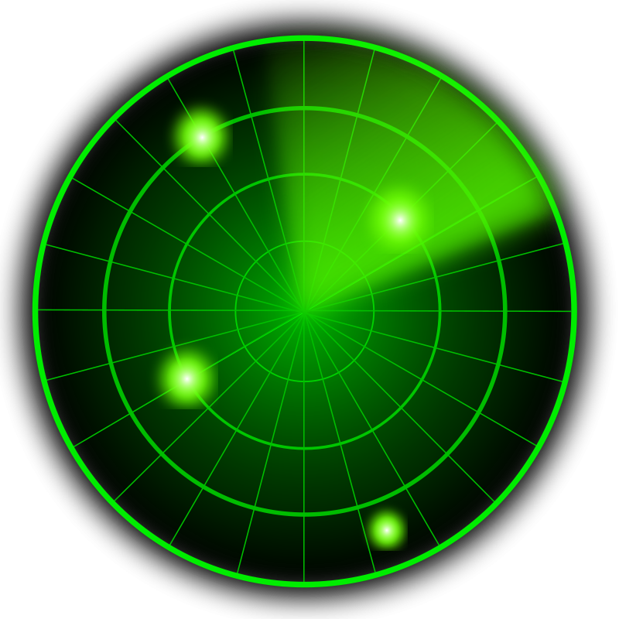



1. Product Overview
The system we designed include three parts:
‘Gamified’ Module
‘Smile Recognize’ Module
Talent Loss Detecting
1. We 'gamify' each employee's' career. For example, there are gamification-career record system and many game ‘indicators’ such as 'level', 'experience' and etc.
2. By contrasting whether they smile or not before and after one day's work, we could predict whether they satisfy with today's work by their smile.
3. We collect the data from pre two parts. By combining this important data with other human resources information, we could use them to detect the potential leaving employee.
Notes:
We 'gamify' each employee's' career. For example, there are gamification-career record system and many game ‘indicators’ such as 'level', 'experience' and etc. On the one side, this structure hope to relieve employees from boring works. On the other side, we would like to build a sense of belonging for each employee. This could solve the talent loss problem from root. This structure is achieved through database design. Because it is not covered in this course, we won't mentioned any details in the following.
second part of the system is our face recognition technology for identity verification in access system. It will not only recognize our employees' face but also detect whether they smile or not. By contrasting whether they smile or not before and after one day's work, we could predict whether they satisfy with today's work by their smile. After collecting enough data, we could compute each employee's 'satisfaction level'. This part use the machine learning knowledge. We would introduce the details in the following.
could collect the data of employee's satisfaction level by using face and smile recognition part. By combining this important data with other human resources information, we could use them to detect the potential leaving employee. This could solve the talent loss problem from the 'surface'. But, it is quite useful and will get effect instantly. We would introduce the details in the following.

Slide 4


Slide 5
3. Product analysis
Product / Service
Product Name: Backbone
Target Market: Every company who care talents
SWOT Analysis

Slide 6
4. Product Tech Description
About the Data
We have 15000 observations. We want to analysis why are our best and most experienced employees leaving prematurely with these data and make a prediction model to predict potential leaving employee.

Slide 7
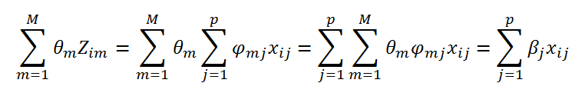
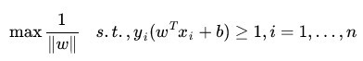
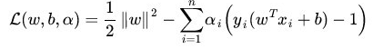
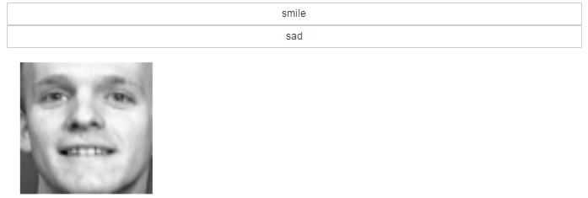
4. Product Tech Description
The Analysis Procedure:
THE ANALYSIS
OF
Step 1. Data Exploration
PCA
Dataset
fetch_lfw_people
fetch_olivetti_faces
SVM
‘Smile Recognize’ Module
We use two datasets from scikit-learn.org to analyze. The fetch_lfw_people data set is used for doing face recognition and the fetch_olivetti_faces data set is used for judging whether a person is smiling. Here we use all of the data in fetch_lfw_people and only 50 images in fetch_olivetti_faces. Otherwise we get some photos in our daily life to assess the accuracy of the smiling classification.
GUI Sample

Slide 8
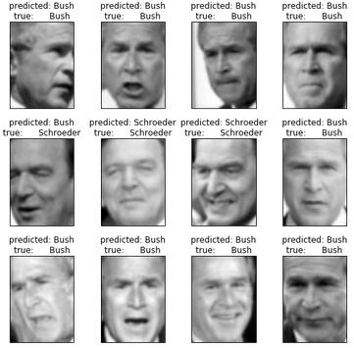
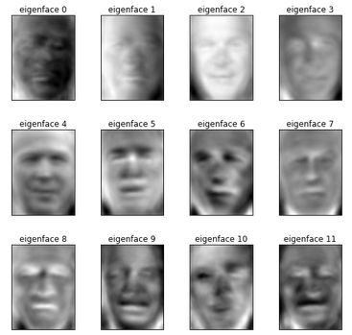
4. Product Tech Description
The Analysis Procedure:
THE ANALYSIS
OF
Step 2. Modeling
‘Smile Recognize’ Module
Predicted & True
Eigenface

Slide 9

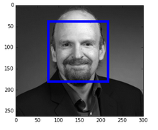


4. Product Tech Description
The Analysis Procedure:
THE ANALYSIS
OF
Step 3. Demo
‘Smile Recognize’ Module

Slide 10
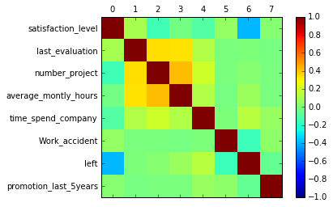
4. Product Tech Description
The Analysis Procedure:
THE ANALYSIS
OF
Step 1. Data Exploration
This graph present the correlations between each variables. The color of the box reveal the significance of the correlation, while the color present the direction (either positive or negative). From this plot, the relations between left and other variables are not obvious.
Talent Loss Detecting

Slide 11
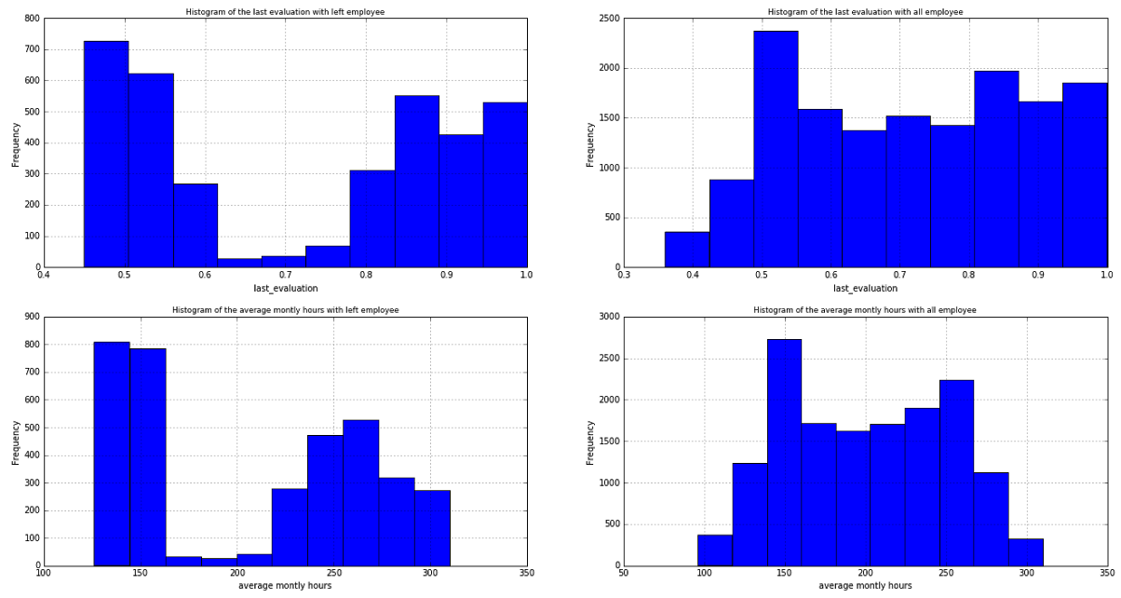
4. Product Tech Description
The Analysis Procedure:
THE ANALYSIS
OF
Step 1. Data Exploration
We next create a data frame with only the people that have left the company, so we can visualize what is the distribution of each features. Then, we compare those features’ distributions with the data including all the employee. The aim is to find some characters of leaving employee. The difference between these two datasets are circled in the following histogram.
Talent Loss Detecting
Last_evaluations
Last_evaluations
Average monthly hours
Average monthly hours

Slide 12
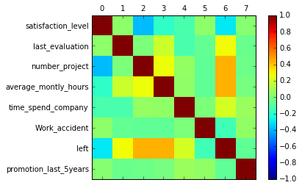
4. Product Tech Description
The Analysis Procedure:
More problematic, company only want to retain those ‘good’ employee. So, we create the dataset include the total of employees that received an evaluation above average (0.7), or spend at least four years in the company, or were working on more than 5 projects at the same time and still have left the company. These are the people the company should have retained. Then, we create the correlation matrix again and try to find some variables which are correlated with ‘good’ employee’s leaving. And, this time, it’s much clearer. month and aren’t promoted. On average valuable employees that leave are not satisfied, work on many projects, spend many hours in the company .
THE ANALYSIS
OF
Step 1. Data Exploration
Talent Loss Detecting

Slide 13
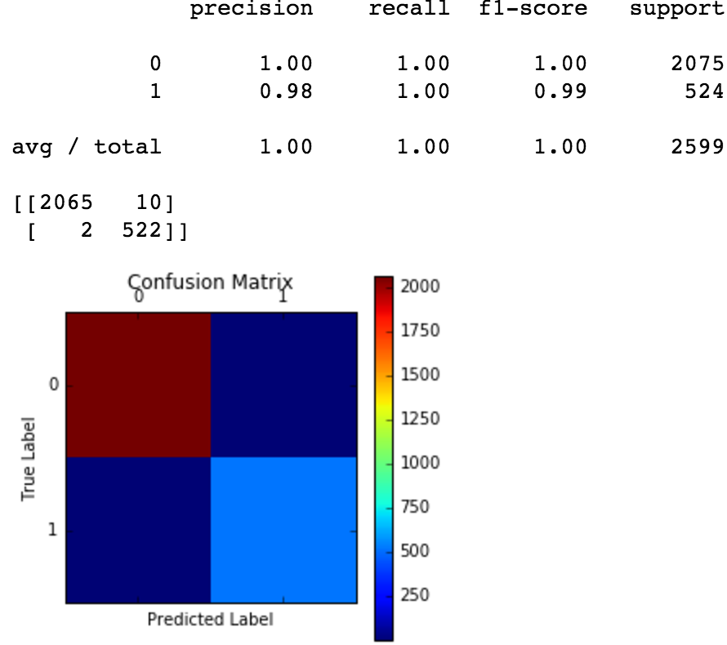
4. Product Tech Description
The Analysis Procedure:
THE ANALYSIS
OF
Step 2. Modeling
Talent Loss Detecting

Slide 14
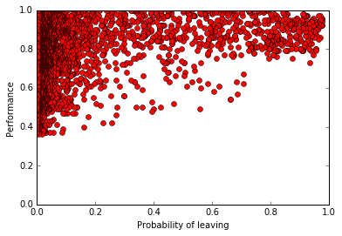
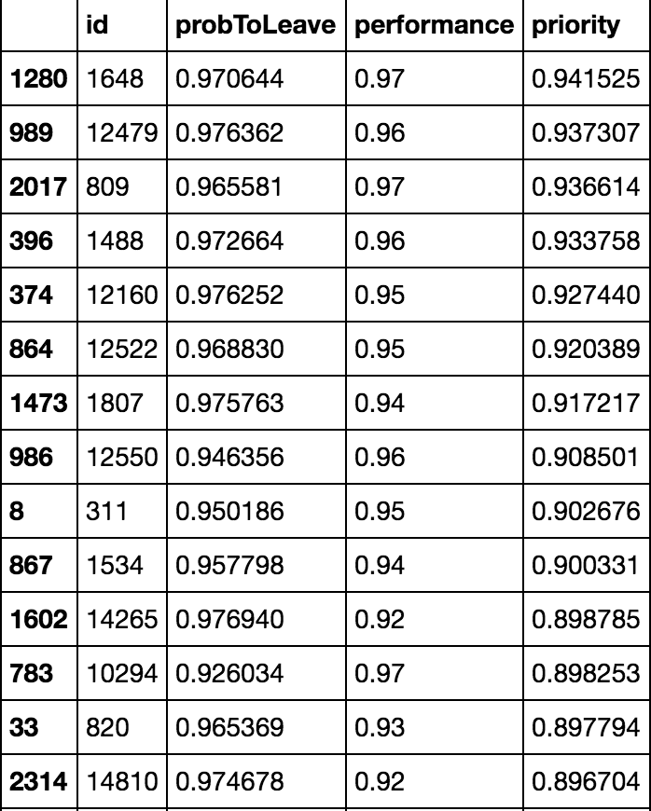
4. Product Tech Description
The Analysis Procedure:
THE ANALYSIS
OF
Step 3. Actionable Insights and Visualization
Talent Loss Detecting
Priority= ProbToLeave*Performance
Notes:
Priority= ProbToLeave*Performance

Slide 15
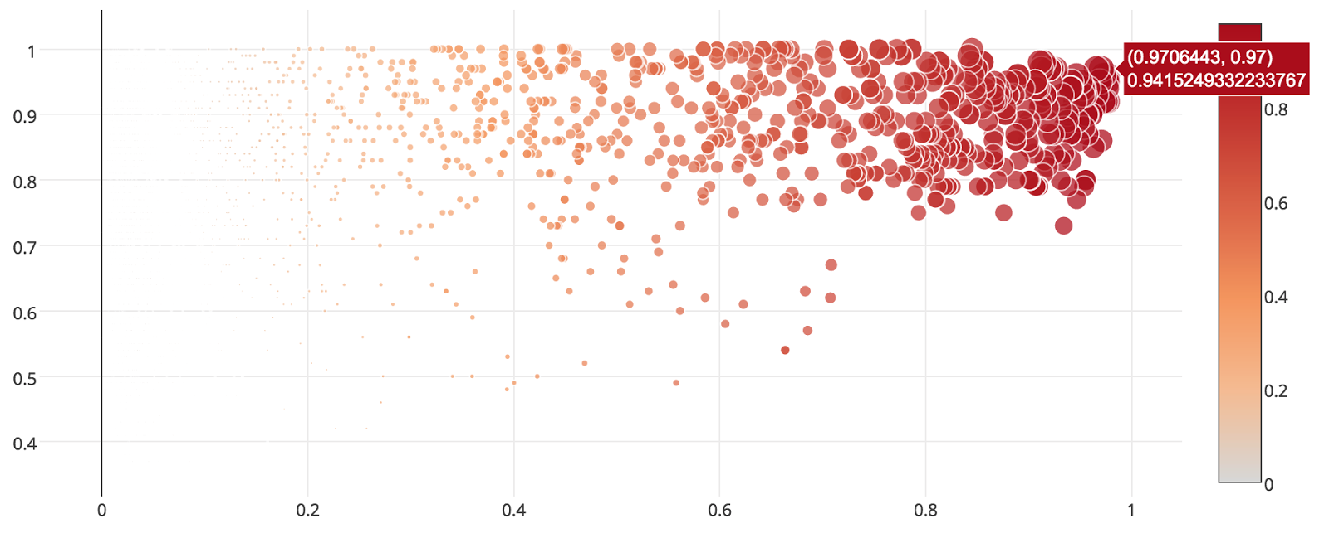
4. Product Tech Description
The Analysis Procedure:
THE ANALYSIS
OF
Step 3. Actionable Insights and Visualization
Talent Loss Detecting

Slide 16
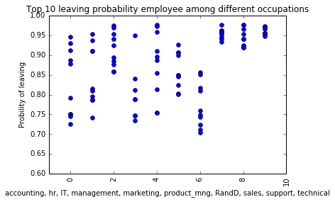
4. Product Tech Description
The Analysis Procedure:
THE ANALYSIS
OF
Step 3. Actionable Insights and Visualization
Department:
Technical
Support
Sales
Talent Loss Detecting

Slide 17
5. THE SUMMARY

